Slide 1

Hydration Manager
Anthony Frazier
George Clayton
Jacob Huffstetler
Jaymel Dash
Justin Schneider
@afraznein
@george-clayton
@jacobah
@DJaymel
@Justin-Schneider
A University of South Carolina Capstone Project

Slide 2



Client and Scope
Hydration-Manager seeks to aid the athletic training staff at the University of South Carolina. The training staff currently use a pencil and paper method of tracking water weight loss by weighing athletes before and after practice. The trainers then input this data into an Excel spreadsheet to calculate athlete hydration status.
The inherent problem here is that by the time this data is generated, the athlete is no longer around training room and this data is not usable in any sort of real time frame.

Slide 3


Client and Scope
The purpose of Hydration-Manager is to shift this process to an online, web-based application. The application will alert staff immediately via SMS if athletes are dehydrated, improving response time for cases of severe dehydration and promoting the overall health of student athletes.
In addition to the immediate alerts, the training staff will also be able to utilize this system to track more long term hydration problems, basing their calculations on a base weight (from the start of the season) to identify athletes that may be considered `ok` on a daily hydration level, but that are actually having more severe season hydration problems.

Slide 4





Technologies

Slide 5
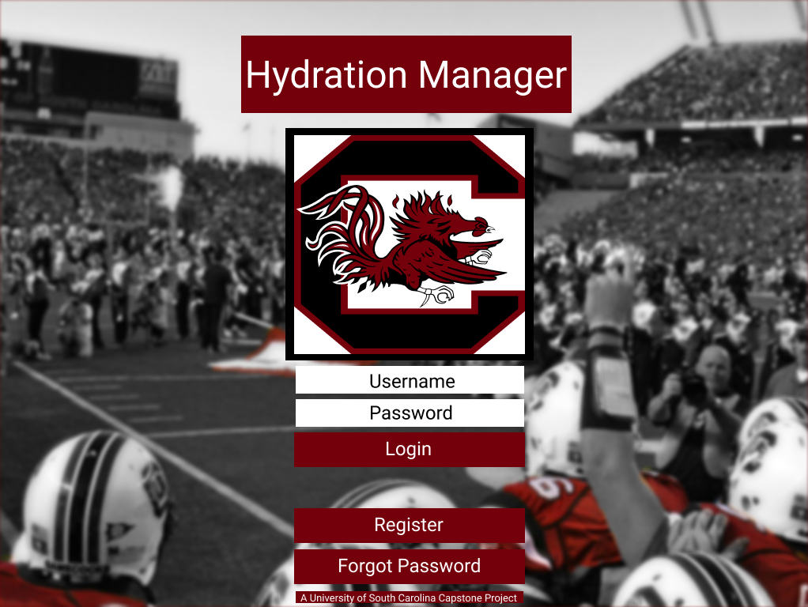
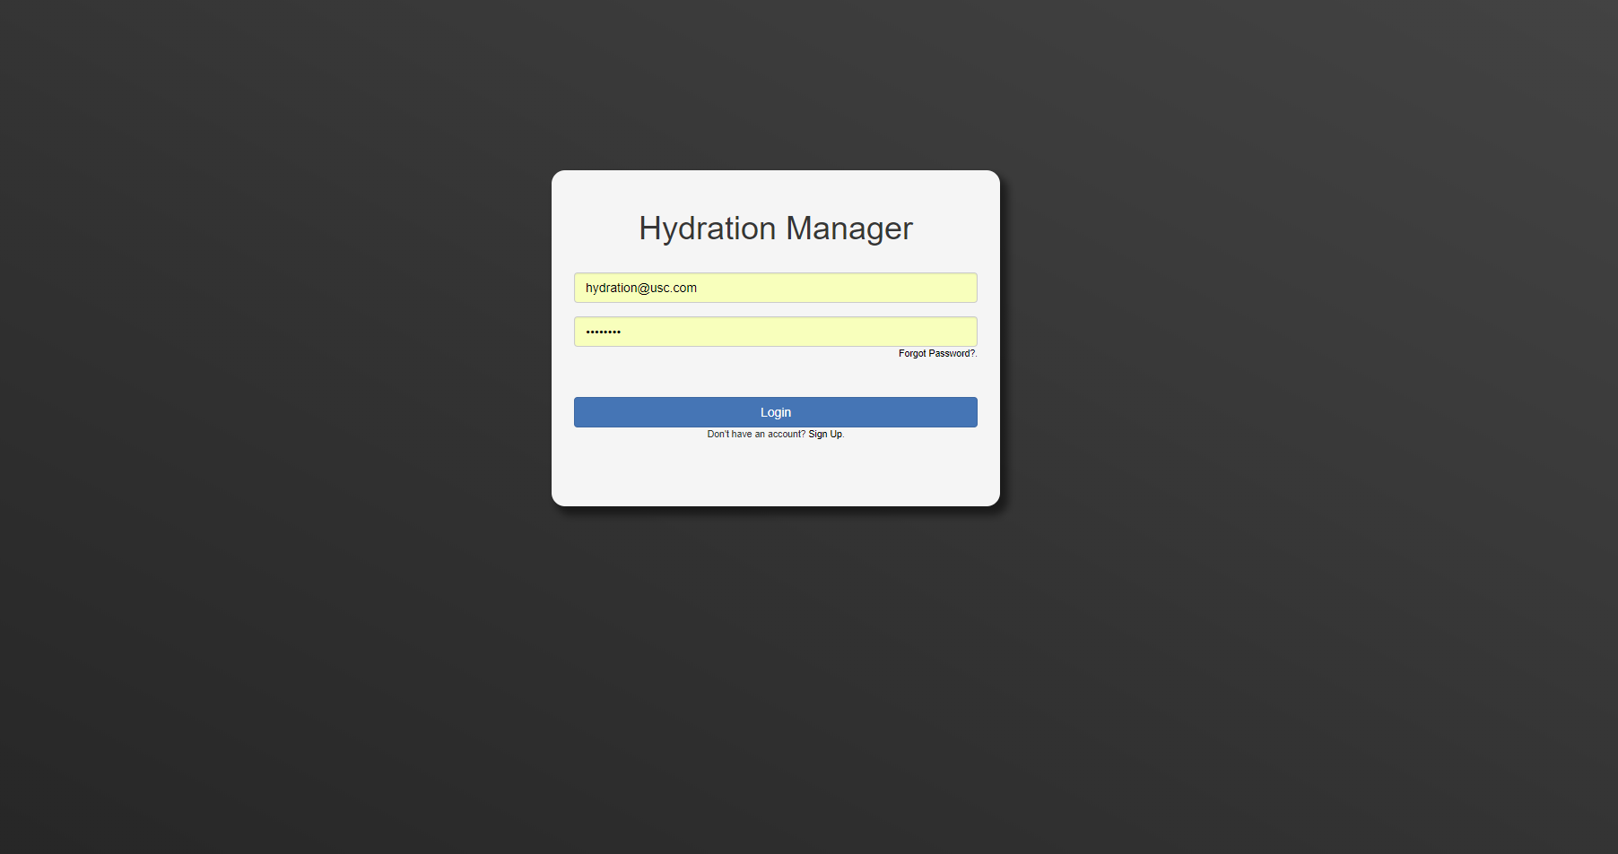
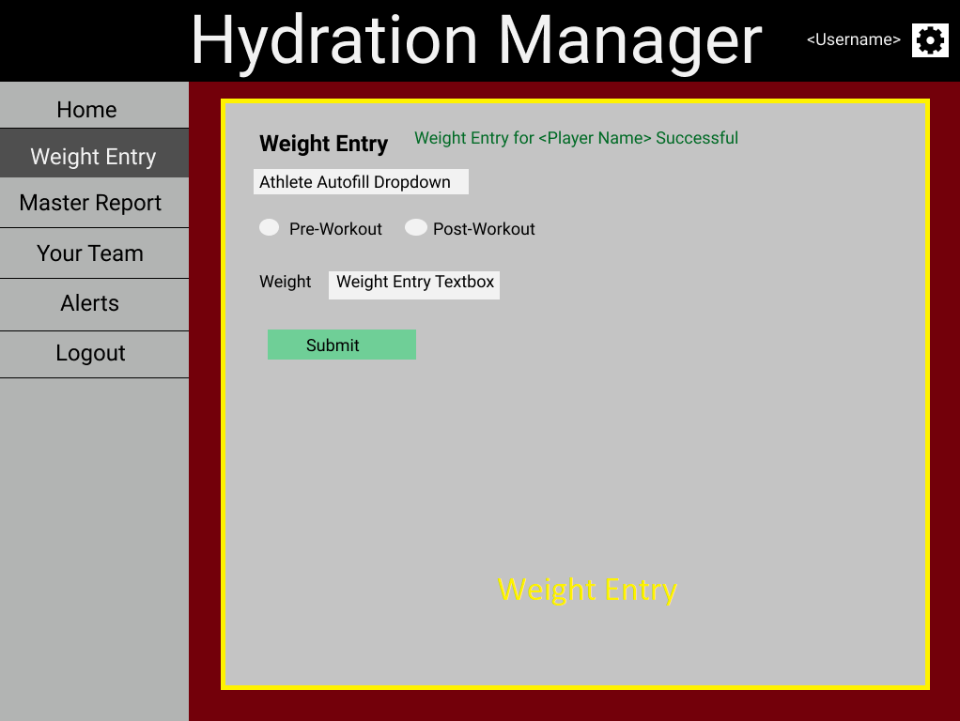
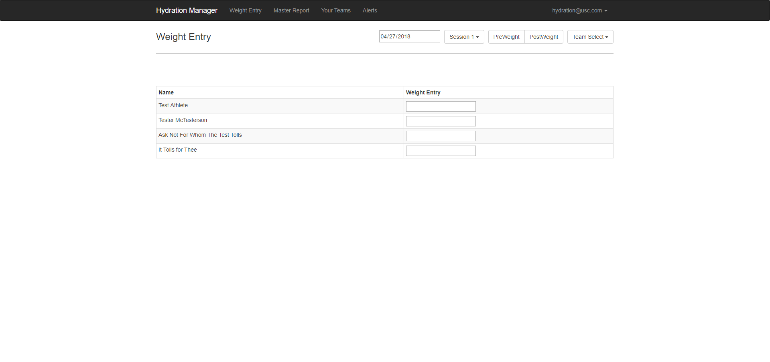

Slide 6
